Slide 1

Smart Health Prediction System
Himanshu bulani(S24CSEU2099)
Arnav meghlan(S24CSEU2057)
Advay Sinha(S24CSEU20__)
BATCH-81

Slide 2

The Problem
Data Kept Separate
Hard for Computers to Learn
Patient health information is often stored in different hospitals and kept private because of strict rules like GDPR and HIPAA.
Because this data is scattered, it's difficult to gather it all. This makes it tough to teach computer programs (AI) to make good predictions.
What Happens When Data is Scattered
Computers make less accurate predictions.
Their predictions don't work well for everyone.
They can't predict much at all.
We need a way for hospitals to help train these computer programs without sharing private patient details.

Slide 3




Our Solution
This project uses a method called **Federated Learning**. It lets many hospitals work together to teach a smart computer program how to make predictions, all while making sure patient information stays private and never leaves each hospital.
Patient Info Stays Put
The actual patient information never leaves the hospital's safe computer system.
Only Learning Updates are Shared
Instead of patient data, just small updates from the computer program's learning process are sent to a main computer.
Main Computer Combines Updates
This main computer collects all the learning updates from different hospitals and mixes them together to improve the overall smart program.
This smart way of working together keeps patient information **private**, can **grow to include many hospitals**, and makes the prediction program much **more accurate** using information from various sources.

Slide 4

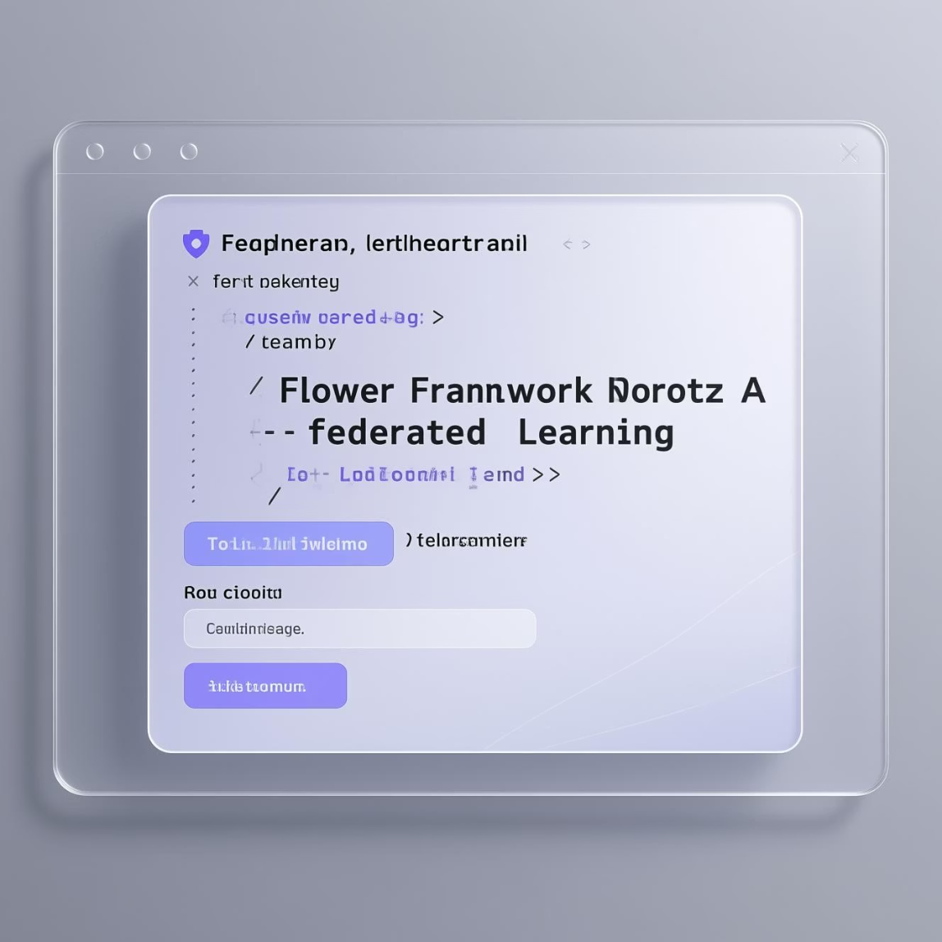

Our Plan
01
02
03
Keeping Patient Data Private
Making Predictions More Accurate
Proving it Works in Practice
We help hospitals work together to build smart computer models. They can do this without anyone ever seeing private patient information, always following strict privacy rules.
By using information from many different hospitals, our computer models become much better at predicting diseases correctly.
We show how our secure computer learning system works in a realistic pretend hospital setting, using a tool called the Flower Framework.
Later, we'll look into even smarter ways to protect privacy (like a method called 'differential privacy') and make our system easier to use for everyone.

Slide 5






How Our Technology Works
Our special healthcare prediction system uses a strong set of reliable tools and programs. This makes sure it works well and can grow as needed.
Python
Flower (FLWR)
This is our main computer language. We use it to build and run all parts of the system.
This is our main system for "federated learning." It helps different groups train computer models together without sharing their private patient data.
AI Model Tools
Handling Data
We use Scikit-learn and PyTorch to create our AI models and give them smart learning features, like those found in advanced "neural networks."
Pandas and NumPy are tools that help us manage and work with large amounts of numbers and information very quickly and easily.
Data Format
Tracking Changes
We often use simple CSV files to easily exchange and share structured data when it's appropriate.
GitHub helps our team work together, keep track of all the code, and manage different versions of our software as we develop it.

Slide 6












Key Features: A Secure and Collaborative AI
Our healthcare AI system has many features that will change how we use AI in healthcare, while keeping patient information safe.
Keeps data private
Many hospitals can join
Ensures private patient information stays locked up and only on each hospital's computers.
Lets many different hospitals work together easily on improving AI.
No data sharing
More accurate predictions
No need to move patient data around, which makes it much safer and lowers security risks.
Uses many different kinds of data from various sources to make better and more reliable predictions.
Works with all AI types
Grows with needs
Can use many kinds of AI methods, from basic ones to very smart, advanced ones.
Designed to easily grow and handle more hospitals and more patient data as our needs increase.

Slide 7
What's Next: Making Federated AI Even Better and Easier to Use
Our project sets the stage for big improvements in how AI can be used in healthcare while keeping patient data private. Here are some exciting things we plan to do next:
Better Privacy
1
We'll add advanced privacy features like Differential Privacy and Secure Multiparty Computation to make sure data is even safer.
2
Use Real Hospital Data
We'll work with hospitals to use their actual patient data. This helps us test and prove our system works well in different real-world medical situations.
Easy-to-Use Online Service
3
We plan to offer our system as a simple online service (Software-as-a-Service). This will make it much easier for more hospitals to access and start using it.
4
Clear Visual Reports
We'll create easy-to-understand charts and dashboards for doctors and nurses. These will show them useful information and insights from our AI models.
Support for Small Devices
5
We'll make it possible for our AI system to work on small devices like smartphones and other smart gadgets used in hospitals.

Slide 8
Thank You!

